Slide 1
ARCHER Tips and Tricks
A few notes from the CSE team

Slide 2
Reusing this material
This work is licensed under a Creative Commons Attribution-NonCommercial-ShareAlike 4.0 International License.
http://creativecommons.org/licenses/by-nc-sa/4.0/deed.en_US
This means you are free to copy and redistribute the material and adapt and build on the material under the following terms: You must give appropriate credit, provide a link to the license and indicate if changes were made. If you adapt or build on the material you must distribute your work under the same license as the original.
Note that this presentation contains images owned by others. Please seek their permission before reusing these images.

Slide 3
Outline
Using Intel MKL
Impact of HyperThreads
Showing process/thread placement
Performance analysis: hardware counters on ARCHER
Debugging: Disabling autotuning in Cray BLAS
Enabling and using ATP

Slide 4
Intel MKL
MKL can be used as an alterantive for LibSci
We have seen cases where either is better
Worth experimenting
Not interfaced through modules
Linking using GNU -L$(MKLROOT)/lib/intel64/ -Wl,--start-group -lmkl_gnu_thread \ -lmkl_gf_lp64 -lmkl_core -Wl,--end-group –ldl
Linking using Intel -L$(MKLROOT)/lib/intel64/ -Wl,--start-group -lmkl_intel_lp64 \ -lmkl_core -lmkl_sequential -Wl,--end-group –ldl

Slide 5
Intel MKL (cont.)
The link line is reasonably complicated.
Use the MKL Link Line Advisor: http://software.intel.com/en-us/articles/intel-mkl-link-line-advisor
For ARCHER select:
Product: Intel Composer XE 2013 SP1
OS: Linux
Architecture: Intel(R) 64
Linking: Static
Interface Layer: LP64 (32-bit Integer)
(MPI: MPICH2 if required)

Slide 6
Impact of HyperThreads
HyperThreads allow up to 2 processes/threads to run concurrently on a single physical core
Managed in hardware so context switch is fast
Use CPU resource while one thread is stalled
Very program dependent
Even a small improvement is worth it (as it is free)
Worth testing if it is useful for your program
aprun syntax (2 nodes): aprun –j 2 –n 96 –N 48 …

Slide 7
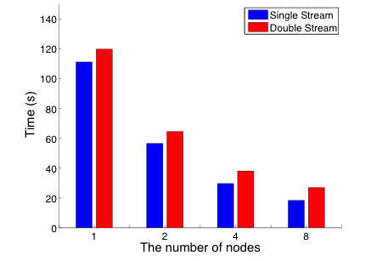
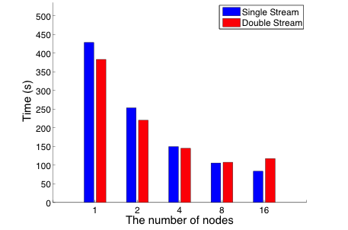
Hyperthreading example performance
XC30: Sandy Bridge (8 cores), fully populated nodes
VASP
NAMD
Effects of Hyper-Threading on the NERSC workload on Edison
http://www.nersc.gov/assets/CUG13HTpaper.pdf

Slide 8
Show Process/Thread Placement
Process/thread placement can have a large impact on performance
Particularly when underpopulating nodes or running mixed-mode (MPI/OpenMP) code.
Add the following lines to your job submission script: export MPICH_CPUMASK_DISPLAY=1 export MPICH_RANK_REORDER_DISPLAY=1

Slide 9
Placement (cont.)
[PE_0]: MPI rank order: Using default aprun rank ordering.
[PE_0]: rank 0 is on nid02421
[PE_0]: rank 1 is on nid02421
[PE_0]: rank 2 is on nid02421
…
[PE_0]: rank 24 is on nid02505
[PE_0]: rank 25 is on nid02505
[PE_0]: rank 26 is on nid02505
…

Slide 10
Placement (cont.)
[PE_0]: cpumask set to 1 cpu on nid02421, cpumask = 000000000000000000000000000000000000000000000001
[PE_34]: cpumask set to 1 cpu on nid02505, cpumask = 000000000000000000000000000000000000010000000000
[PE_33]: cpumask set to 1 cpu on nid02505, cpumask = 000000000000000000000000000000000000001000000000
[PE_35]: cpumask set to 1 cpu on nid02505, cpumask = 000000000000000000000000000000000000100000000000
[PE_47]: cpumask set to 1 cpu on nid02505, cpumask = 000000000000000000000000100000000000000000000000
…

Slide 11
Hardware Counters on ARCHER
CrayPAT allows you to monitor performance at the hardware level
Specify set of performance counters using the PAT_RT_PERFCTR environment variable in script that is running instrumented code: PAT_RT_PERFCTR=1 (Group = 1 shows a summary with floating-point and cache metrics.)

Slide 12
=================================================================
Total
-----------------------------------------------------------------
PERF_COUNT_HW_CACHE_L1D:ACCESS 458227922309
PERF_COUNT_HW_CACHE_L1D:PREFETCH 7837418131
PERF_COUNT_HW_CACHE_L1D:MISS 25703134212
CPU_CLK_UNHALTED:THREAD_P 884128952294
CPU_CLK_UNHALTED:REF_P 29852948968
DTLB_LOAD_MISSES:MISS_CAUSES_A_WALK 219955467
DTLB_STORE_MISSES:MISS_CAUSES_A_WALK 54655340
L2_RQSTS:ALL_DEMAND_DATA_RD 17968418083
L2_RQSTS:DEMAND_DATA_RD_HIT 14820163740
User time (approx) 304.533 secs 822542437366 cycles
CPU_CLK 2.962GHz
TLB utilization 1790.78 refs/miss 3.498 avg uses
D1 cache hit,miss ratios 94.8% hits 5.2% misses
D1 cache utilization (misses) 19.13 refs/miss 2.392 avg hits
D2 cache hit,miss ratio 87.8% hits 12.2% misses
D1+D2 cache hit,miss ratio 99.4% hits 0.6% misses
D1+D2 cache utilization 156.20 refs/miss 19.525 avg hits
D2 to D1 bandwidth 3601.274MB/sec 1149978757281 bytes
Notes:
TLB utilization: with default page size and DP floats should not be less than 512 refs/miss (every double used once)
D1 cache hit,miss ratio: for DP floats, ratio of 87.5% corresponds to each double being used once. Less than this is poor
D1+D2 cache hit,miss ratio: should be high. > 97%

Slide 13
Disable Cray BLAS autotuning
If you are debugging and use the Cray LibSci library then you may want to disable autotuning.
Ensures autotuning is not causing the error.
Add: CRAYBLAS_AUTOTUNING_OFF=1 to your job scripts.

Slide 14
Using ATP
ATP (Abnormal Termination Processing) catches dying applications and produces a merged stack backtrace
Useful for getting more information on crashes
Set: ATP_ENABLED=1 in your job submission script.
There is no need to recompile to use ATP

Slide 15
Using ATP (cont.)
When your program crashes, ATP will:
Produce a stack trace of the first failing process
Produce a visualisation of every processes stack trace
Generate a selection of relevant core files
Visualise the merged stack trace using statview: module add stat statview atpMergedBT.dot
Very simple way to start the debugging process

Slide 16
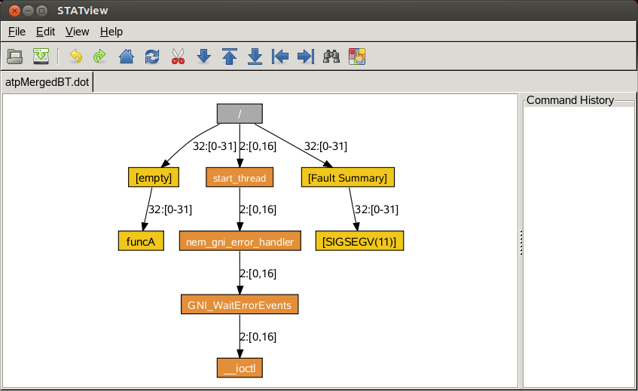
statview (thanks to Cray)

